Slide 1
Learning Objective
I will calculate the length of an arc, area of a sector and area of a segment, when the included angle is in degrees or radians.
Success Criteria
At the end of the lesson, I will be able to:
calculate the length of an arc, area of a sector and area of a segment, when the included angle is in degrees or radians.

Slide 2
Features of a circle
Concept Development
Radius
Diameter
Circumference
Minor Arc
Major Arc
Minor Sector
Major Sector
Chord
Minor Segment
Major Segment
Tangent
Secant

Slide 3


Features of a circle
Concept Development
Radius
Diameter
Circumference
Minor Arc
Major Arc
Minor Sector
Major Sector
Chord
Minor Segment
Major Segment
*Tangent
*Secant
O

Slide 4




Features of a circle
Concept Development
Radius
Diameter
Circumference
Minor Arc
Major Arc
Minor Sector
Major Sector
Chord
Minor Segment
Major Segment
*Tangent
*Secant
O

Slide 5
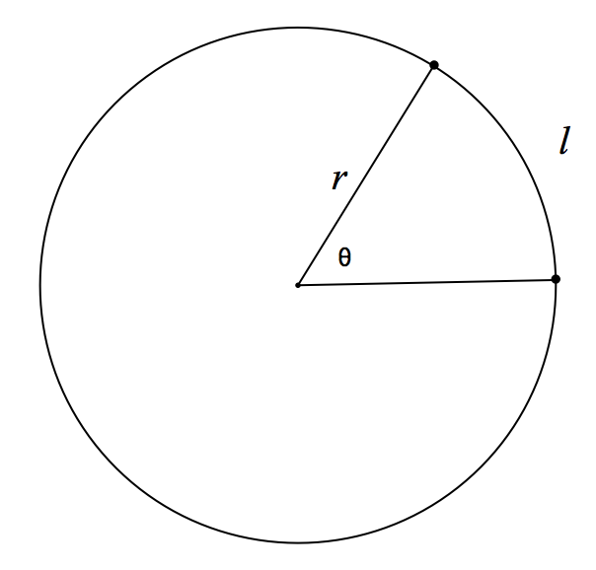
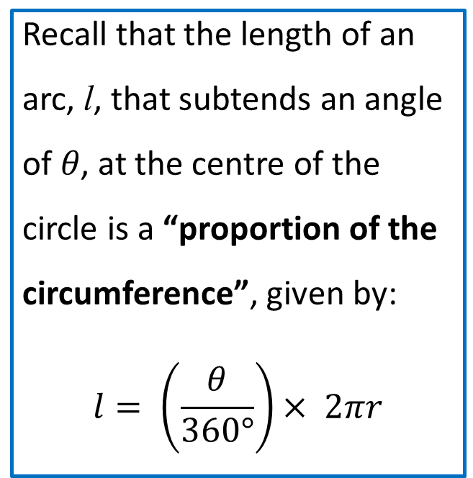
Arc length (in degrees)
Concept Development
Recall that the length of an arc, l, that subtends an angle of 𝜃, at the centre of the circle is a “proportion of the circumference”, given by:
$$l= \left(\frac{θ}{360°}\right)× 2πr$$

Slide 6
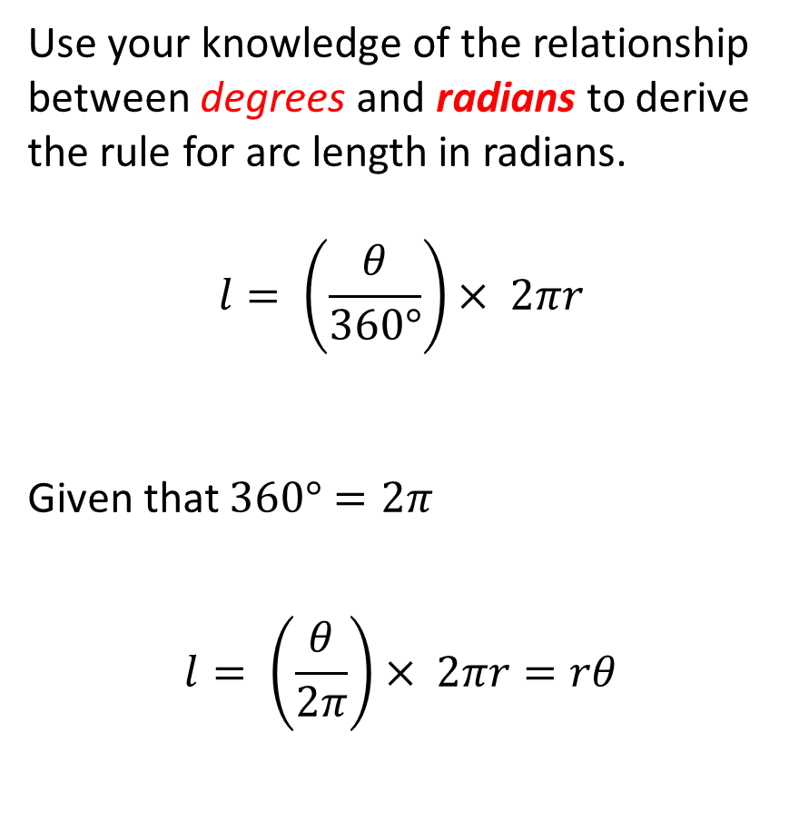
Arc length (in radians)
Concept Development
Use your knowledge of the relationship between degrees and radians to derive the rule for arc length in radians.
$$l= \left(\frac{θ}{360°}\right)× 2πr$$
Given that $360°=2π$
$$l= \left(\frac{θ}{2π}\right)× 2πr=rθ$$

Slide 7
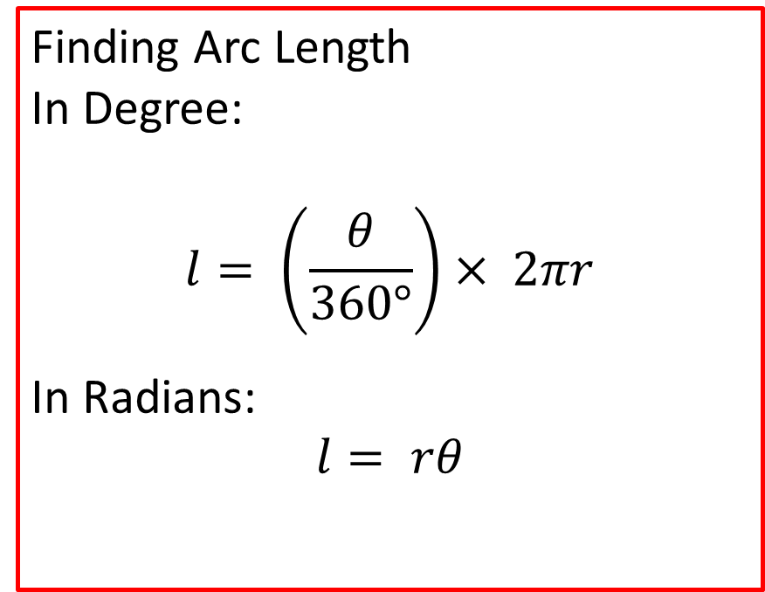
Arc length
Concept Development
Finding Arc Length
In Degree:
$$l= \left(\frac{θ}{360°}\right)× 2πr$$
In Radians:
$$l= rθ$$

Slide 8
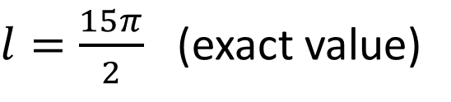
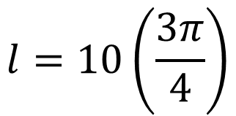

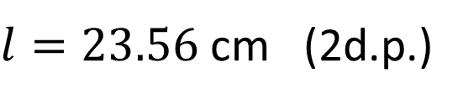
Guided Practice
Calculate the minor arc length of a circle with radius of 10 cm, subtended by an angle of $\frac{3π}{4}$ radians.
$$l=rθ$$
$$l=10\left(\frac{3π}{4}\right)$$
$l=\frac{15π}{2}$ (exact value)
$l=23.56$ cm (2d.p.)

Slide 9
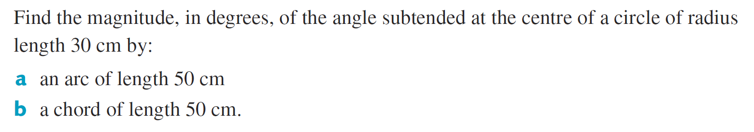

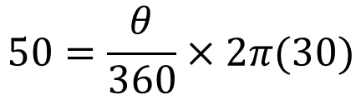

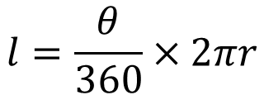
Guided Practice
$$l=\frac{θ}{360}×2πr$$
$$50=\frac{θ}{360}×2π(30)$$
$$θ=95.49°$$
$${50}^{2}={30}^{2}+{30}^{2}−2\left(30\right)\left(30\right)\cos{(θ)}$$
$$θ=112.88°$$

Slide 10
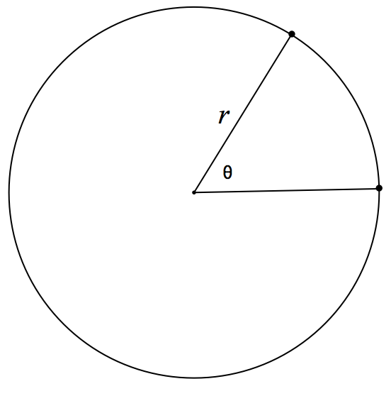
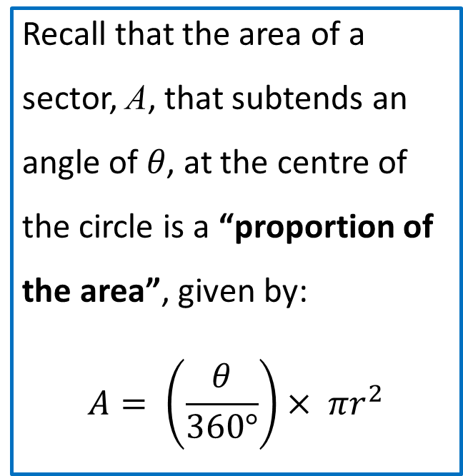
Area of a sector (in degrees)
Concept Development
Recall that the area of a sector, A, that subtends an angle of 𝜃, at the centre of the circle is a “proportion of the area”, given by:
$$A= \left(\frac{θ}{360°}\right)× πr^{2}$$

Slide 11
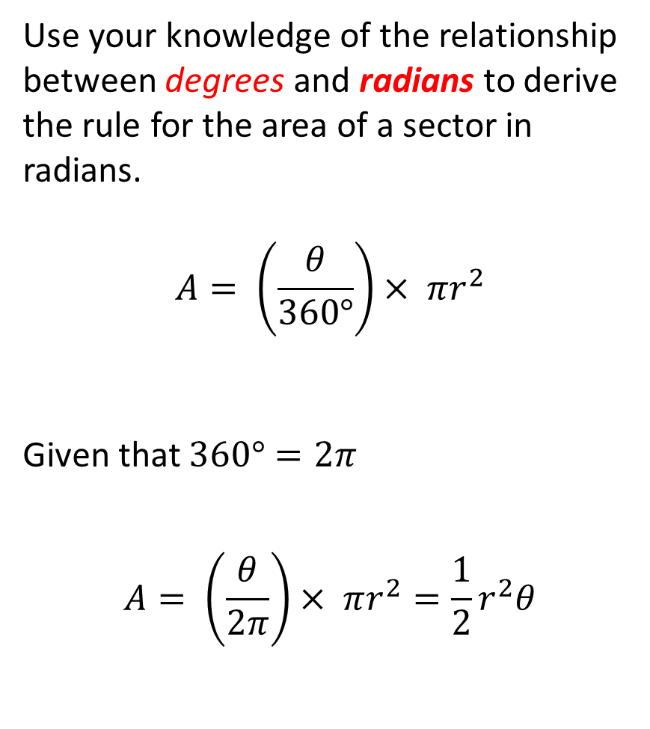
Area of a sector (in radians)
Concept Development
Use your knowledge of the relationship between degrees and radians to derive the rule for the area of a sector in radians.
$$A= \left(\frac{θ}{360°}\right)× πr^{2}$$
Given that $360°=2π$
$$A= \left(\frac{θ}{2π}\right)× πr^{2}=\frac{1}{2}r^{2}θ$$

Slide 12

Area of a sector
Concept Development
In degrees:
$$A= \left(\frac{θ}{360°}\right)× πr^{2}$$
In radians:
$$A= \frac{1}{2}r^{2}θ$$

Slide 13




Guided Practice
Calculate the area of a major sector of a circle with radius of 9 cm, subtended by an angle of $\frac{5π}{3}$ radians.
$$A=\frac{1}{2}r^{2}θ$$
$$A=\frac{1}{2}{\left(9\right)}^{2}\left(\frac{5π}{3}\right)$$
$$A=\frac{135π}{2} cm^{2}$$
$$A=212.06 cm^{2}$$

Slide 14
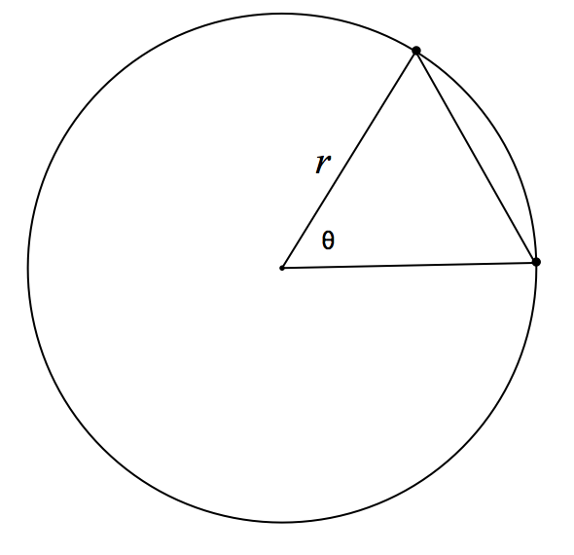

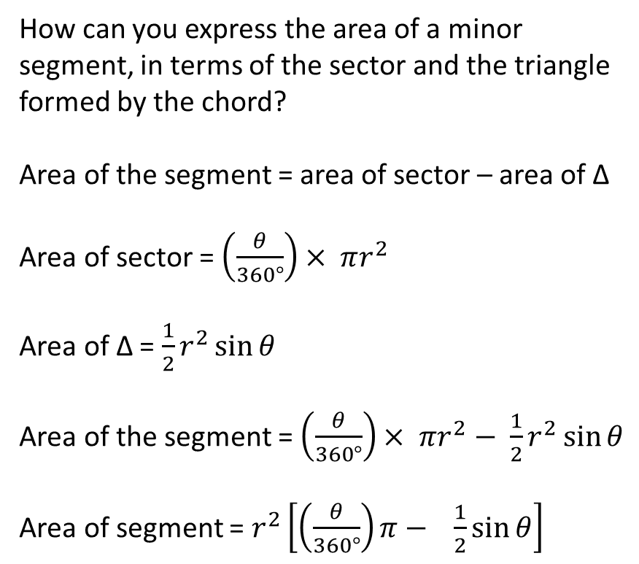
Area of a segment (in degrees)
Concept Development
How can you express the area of a minor segment, in terms of the sector and the triangle formed by the chord?
Area of the segment = area of sector – area of ∆
Area of sector = $\left(\frac{θ}{360°}\right)× πr^{2}$
Area of ∆ = $\frac{1}{2}r^{2}\sin{θ}$
Area of the segment = $\left(\frac{θ}{360°}\right)× πr^{2}−$ $\frac{1}{2}r^{2}\sin{θ}$
Area of segment = $r^{2}\left[\left(\frac{θ}{360°}\right)π− \frac{1}{2}\sin{θ}\right]$

Slide 15
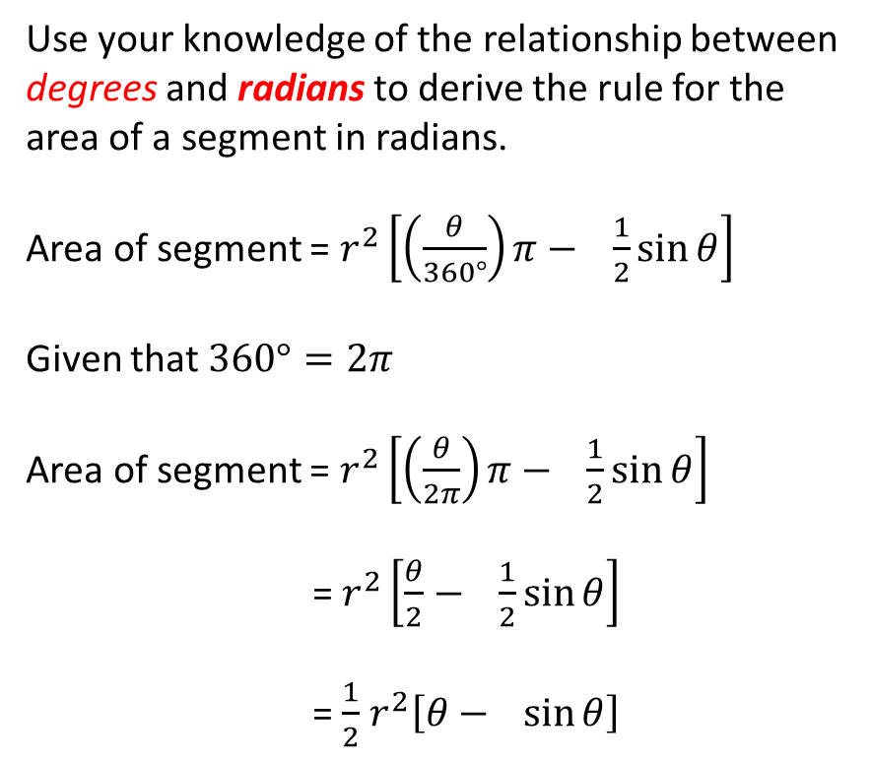
Area of a segment (in radians)
Concept Development
Use your knowledge of the relationship between degrees and radians to derive the rule for the area of a segment in radians.
Area of segment = $r^{2}\left[\left(\frac{θ}{360°}\right)π− \frac{1}{2}\sin{θ}\right]$
Given that $360°=2π$
Area of segment = $r^{2}\left[\left(\frac{θ}{2π}\right)π− \frac{1}{2}\sin{θ}\right]$
= $r^{2}\left[\frac{θ}{2}− \frac{1}{2}\sin{θ}\right]$
= $\frac{1}{2}$ $r^{2}\left[θ− \sin{θ}\right]$

Slide 16
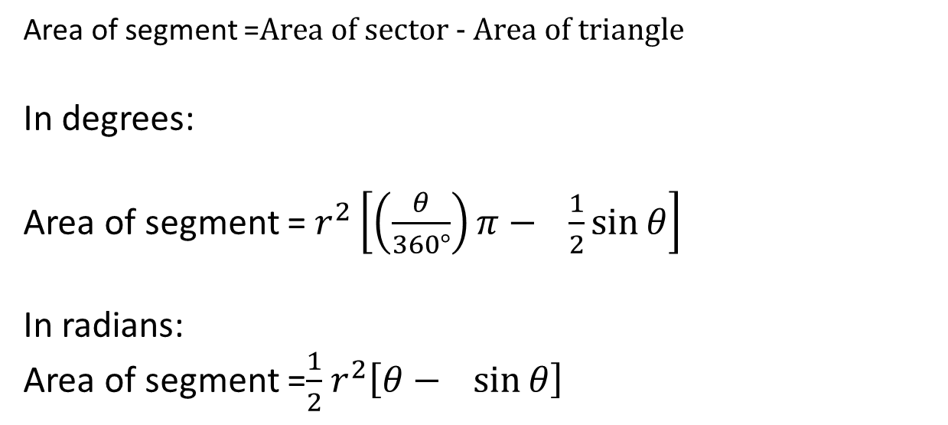
Area of a segment
Concept Development
Area of segment =$\text{Area} \text{of} \text{sector} \text{− }\text{Area} \text{of} \text{triangle}$
In degrees:
Area of segment = $r^{2}\left[\left(\frac{θ}{360°}\right)π− \frac{1}{2}\sin{θ}\right]$
In radians:
Area of segment =$\frac{1}{2}$ $r^{2}\left[θ− \sin{θ}\right]$

Slide 17
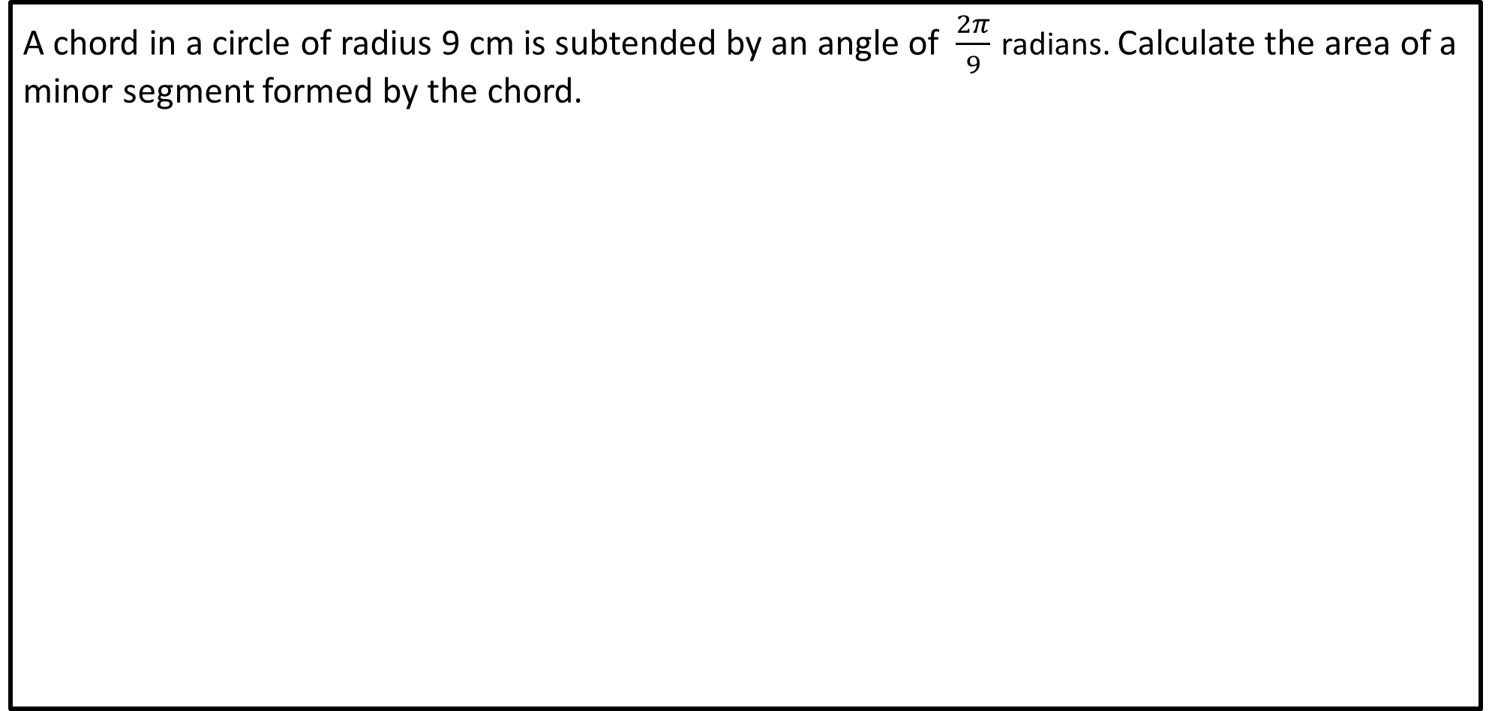

Concept Development
A chord in a circle of radius 9 cm is subtended by an angle of $\frac{2π}{9}$ radians. Calculate the area of a minor segment formed by the chord.
$$A=\frac{1}{2}{\left(9\right)}^{2}\left(\frac{2π}{9}\right)−\frac{1}{2}{\left(9\right)}^{2}\sin\left(\frac{2π}{9}\right)$$
$$A=2.24 cm^{2}$$

Slide 18
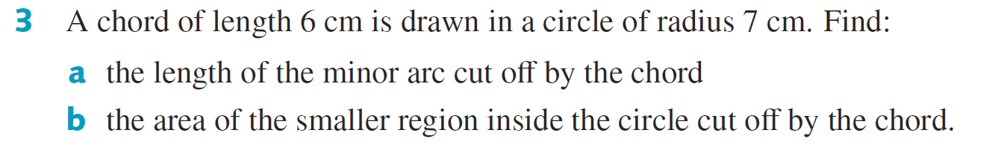
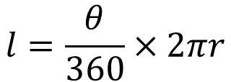



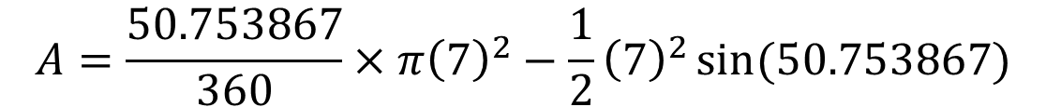
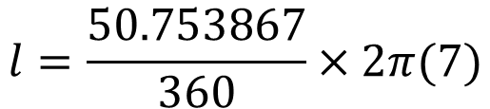
Guided Practice
$$6^{2}=7^{2}+7^{2}−2\left(7\right)\left(7\right)\cos{(θ)}$$
$$θ=50.753867°$$
$$l=\frac{θ}{360}×2πr$$
$$l=\frac{50.753867}{360}×2π(7)$$
$$l=6.20 cm$$
$$A=\frac{50.753867}{360}×π{\left(7\right)}^{2}−\frac{1}{2}{\left(7\right)}^{2}\sin{(50.753867)}$$
$$A=2.73 cm^{2}$$

Slide 19
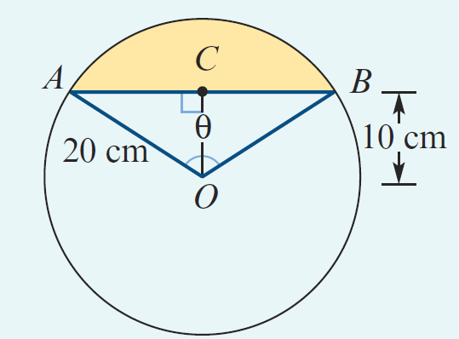



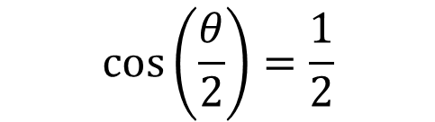

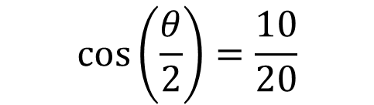


Guided Practice
$$\cos\left(\frac{θ}{2}\right)=\frac{10}{20}$$
$$\cos\left(\frac{θ}{2}\right)=\frac{1}{2}$$
$$\frac{θ}{2}=60°$$
$$A=\frac{400π}{3}−100\sqrt{3}$$
$$θ=120°$$
$$A=\frac{120}{360}×π{\left(20\right)}^{2}−\frac{1}{2}{\left(20\right)}^{2}\sin{(120)}$$
$$A=\frac{100}{3}(4π−3\sqrt{3})$$
$$A=\frac{400π}{3}−\frac{200\sqrt{3}}{2}$$

Slide 20
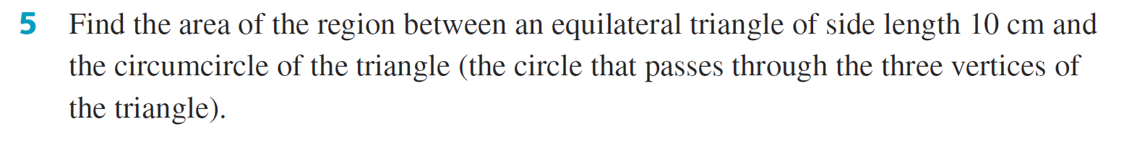




Guided Practice
$${10}^{2}=x^{2}+x^{2}−2\left(x\right)\left(x\right)\cos{(120)}$$
$$x=5.7735 cm$$
$$Area of region=Area of circle −Area of triangle$$
$$Area of region=π{\left(5.7725\right)}^{2}−\frac{1}{2}{\left(10\right)}^{2}sin⁡(60)$$
$$Area of region=61.42 cm^{2}$$

Slide 21
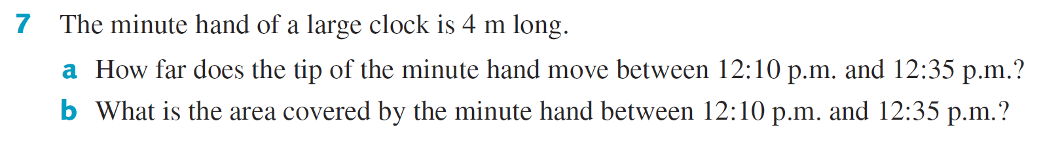
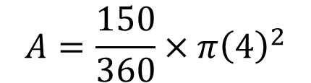

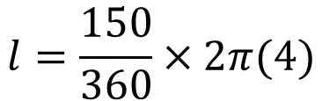
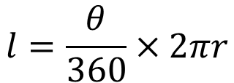

Guided Practice
$$l=\frac{θ}{360}×2πr$$
$$l=\frac{150}{360}×2π(4)$$
$$l=10.47m$$
$$A=\frac{150}{360}×π{\left(4\right)}^{2}$$
$$A=20.94m^{2}$$

Slide 22
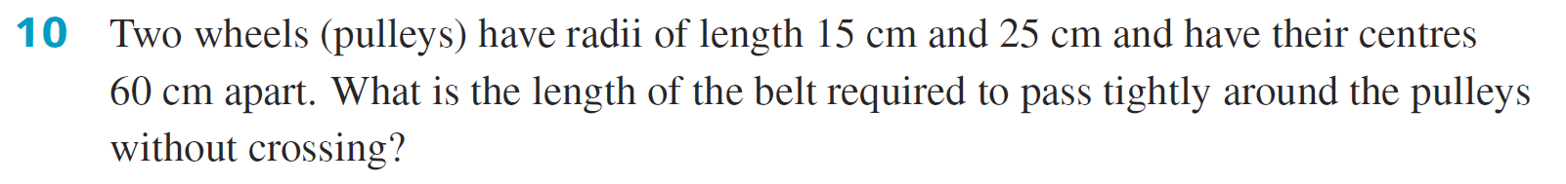







Guided Practice

Slide 23
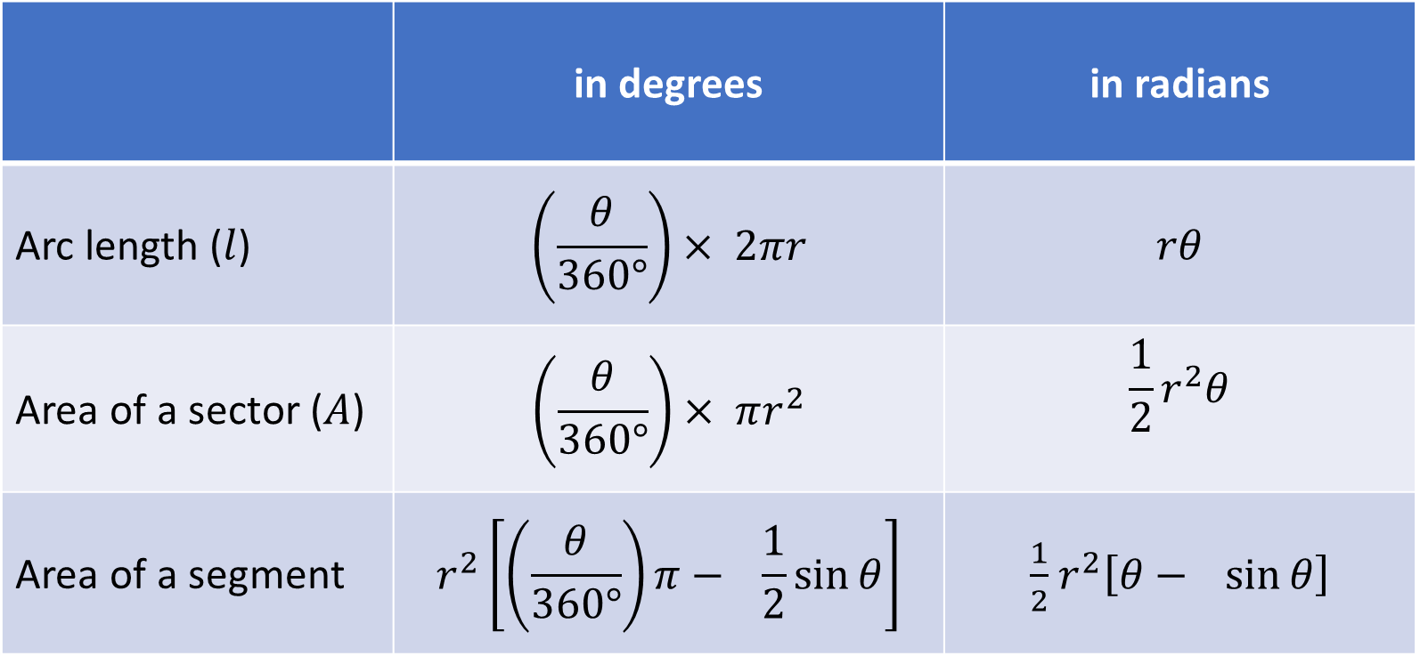
Summary
 | in degrees | in radians
Arc length ($l$) | $$\left(\frac{θ}{360°}\right)× 2πr$$ | $$rθ$$
Area of a sector ($A$) | $$\left(\frac{θ}{360°}\right)× πr^{2}$$ | $$\frac{1}{2}r^{2}θ$$
Area of a segment | $$r^{2}\left[\left(\frac{θ}{360°}\right)π− \frac{1}{2}\sin{θ}\right]$$ | $\frac{1}{2}$ $r^{2}\left[θ− \sin{θ}\right]$

Slide 24
Independent Practice
Complete Cambridge Ex 13E

